Slide 1

Major PROJECT PRESENTATION – I (FreeCom)

Slide 2

Shri Vaishnav Vidhyapeeth Vishwavidyalaya Shri Vaishnav Institute of Information and Technology
Department of Computer Science and Engineering Title: - FreeCom
Subject: - Major Project
Subject Code: - BTCS706
Guided By: -
Mr. Pritesh Kumar Jain
Assistant Professor
CSE Department
SVIIT, SVVV Indore
Presented By: -
Deva Ganesh Nair (19100BTCSAII05257)
Divyam Pithawa (19100BTCSAII05259)
Janish Pancholi (19100BTCSAII05265)
Sarthak Nahar (19100BTCSAII05283)

Slide 3
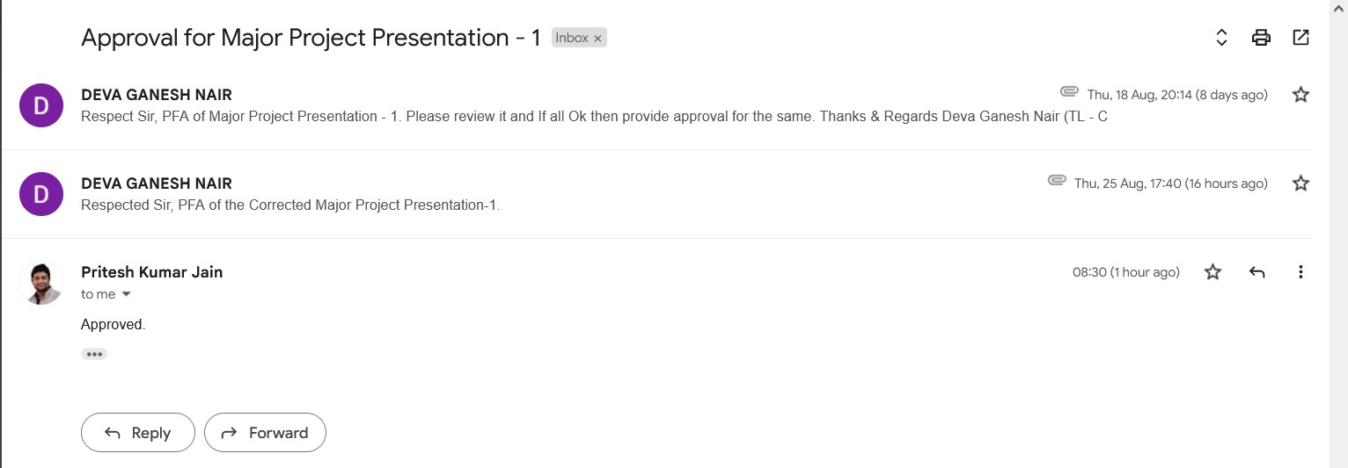
Approval of Presentation from Project Guide

Slide 4
CONTENTS
Introduction
Problem Domain
Literature Survey
Feasibility Study
References

Slide 5
Introduction
1

Slide 6
introduction
In today’s hyper-competitive e-commerce scenario, retail players grab every opportunity to attract potential customers. FreeCom is Web application which will help the customer to make an informed decision while using e-commerce website or retail stores for buying a electronic products.
FreeCom is designed to compare the price and specifications of electronic goods from a range of providers, which will help consumers in making decision to choose products that will save their money through online. It will also provide a mechanism to verify the authenticity of the product by the use of QR code Reader. User/Customers will get creative art/logos/images from the purchases they have made from the brands, and they may get future discount/offers. There is also a trending products panel which will help user to find trending products from Amazon.
2

Slide 7
Problem domain
Objectives
Block Diagram
3

Slide 8
Problem domain
Consumer confused by many e-commerce website selling the same product.
Consumer wanting specifications of the product on touch/scan.
Retailer having to employ individuals with knowledge of specifications of the product.
Brand/Company want useful interaction with the customer.
Scam/fake product present on e-commerce, need authentication mechanism.
Customer wanting to know the trending product on e-commerce websites.
4

Slide 9
Objectives
To compare the prices of the same product from different e-commerce sites and show the cheapest of the two products.
To compare any two electronic devices on the basis of their specifications and show the comparison to the customer.
To ensure the authenticity of the product that the customer bought by scanning the QR code available on the product.
To increase price consciousness among consumers.
Obtaining leads by marketing our web app to consumers who want hassle-free services by providing QR-based comparison in retail stores.
Trending products are displayed to help the companies analyse the trends and the market.
5

Slide 10
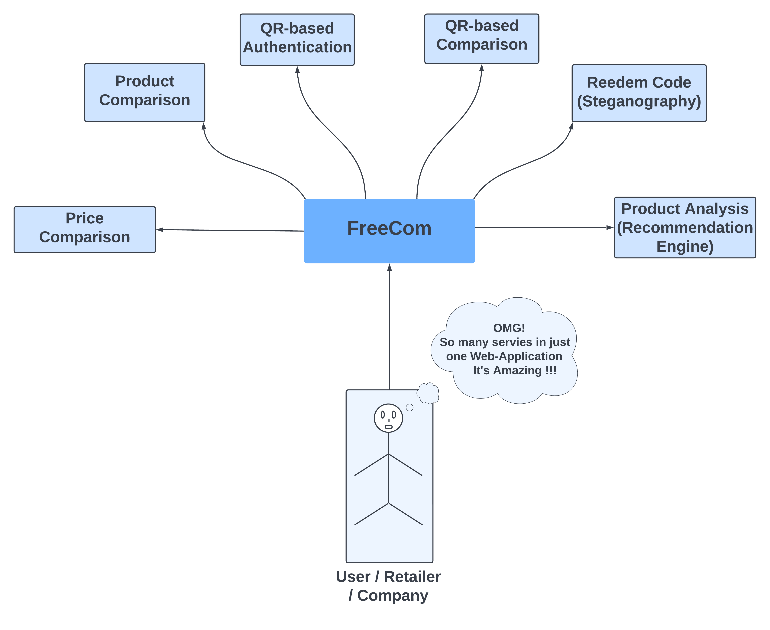
Block diagram
Figure Number - 1
6

Slide 11
LITERATURE SURVEY
7

Slide 12
LITERATURE SURVEY
1.Indian Sites
Naaptol
Perhaps, this particular site is one of the oldest players in the price comparison sector. Irrespective of the product, you can compare costs and then finalize your purchase.
PricePanda
If you love to buy electronic items, laptops, computers, and gaming consoles, PricePanda will be your best online price comparison partner. The site caters to users in Latin American and South-East Asian countries like Indonesia, Mexico, Malaysia, and the Philippines.
2.International Sites
Google Shopping
Google Shopping is one of the largest price comparison shopping engines available to online shoppers. Products available on Google Shopping are also visible on standard Google search results. Google Shopping is also integrated with Google Ads – one of the best pay-per-click platforms.
Yahoo Shopping
Yahoo Shopping is a great price comparison website for online shoppers. You can create a wish list of the products you desire to track the prices of, and Yahoo Shopping will monitor the price changes overtime for you.
8

Slide 13
Feasibility study
Technical Feasibility
Economical Feasibility
Operational Feasibility
Expected Progress
9

Slide 14
FEASIBILITY STUDY
Technical Feasibility
‘FreeCom’ will be available as a Web Application . An open framework might be used to host this Web Application. The usage of such powerful frameworks and programming languages would help in better satisfying the requirements and constraints of the Web Application.
Economical Feasibility
The project is economically feasible as the only cost involved is having a computer with the minimum requirements mentioned in system specifications. For the users to access the application, the only cost involved will be in getting access to the Internet.
10

Slide 15
Operational Feasibility
It is noteworthy that the timeframe of the project is critical given the complexity of the project. Thus, in the early stage of the project, only the basic features would be incorporated. For instance, the purchase from our Web Application cannot be implemented in the initial phase. Moreover, the user interface would be very basic and reflect only the main services offered in the Web Application.
Expected Progress
We are trying to implement all the objectives that we have discussed above and will give our best to complete them within the project time period of 6 months. We are referring to different research and sources to complete our different modules(web services) of the project.
11

Slide 16
references
12

Slide 17
references
https://www.naaptol.com/
https://www.pricepanda.com/
https://www.cloudways.com/blog/price-comparison-websites/
https://influencermarketinghub.com/best-price-comparison-sites/
https://media1.thehungryjpeg.com/thumbs2/ori_3656714_3etd3oh0w1mtjqnx8xcidud34zrgk4erpvvozvm2_monogram-fc-logo-design.jpg
13

Slide 18
THANK YOU
14

